Slide 1
Final Portfolio
Nobutaka Kim
CS6475 - Fall 2019

Slide 2
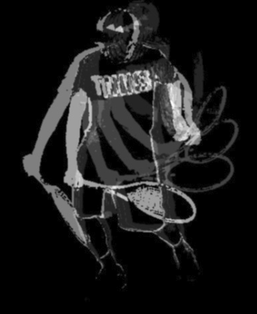
Assignment #1: Epsilon Photography
Making one small change per image and to stack them to create a novel artifact was a good opportunity to make artificial motion blur by adjusting the subject of the image, in this case a tennis backhand swing, by small amounts. I think the flow of the swing comes through well although ideally I would like to reconfigure the pyramid blending scheme so the last position has the highest value between 0 and 255 (so more white) and the starting position lowest or darkest. These types of photographs have been used as teaching aids in Japanese tennis magazines for decades so it was fun emulating it and adding an artistic aspect to the final image which was first gray scaled and then thresholded.
In hindsight, choosing other epsilon such as expsosure, aperture, focal length would have also provided good practice with the camera for later assignments.
I learned a lot from classmates’ assignments and in hindsight could have employed some of their techniques to achieve the same result but with the ability to tune parameters to produce the ideal result image mentioned above.
I would like to learn more about how Photoshop and other commercial or open source software creates binary images and binary masks because opening and closing with combinations of erosion and dilation are not fully automatic methods of eliminating all noise the way I am using them.

Slide 3
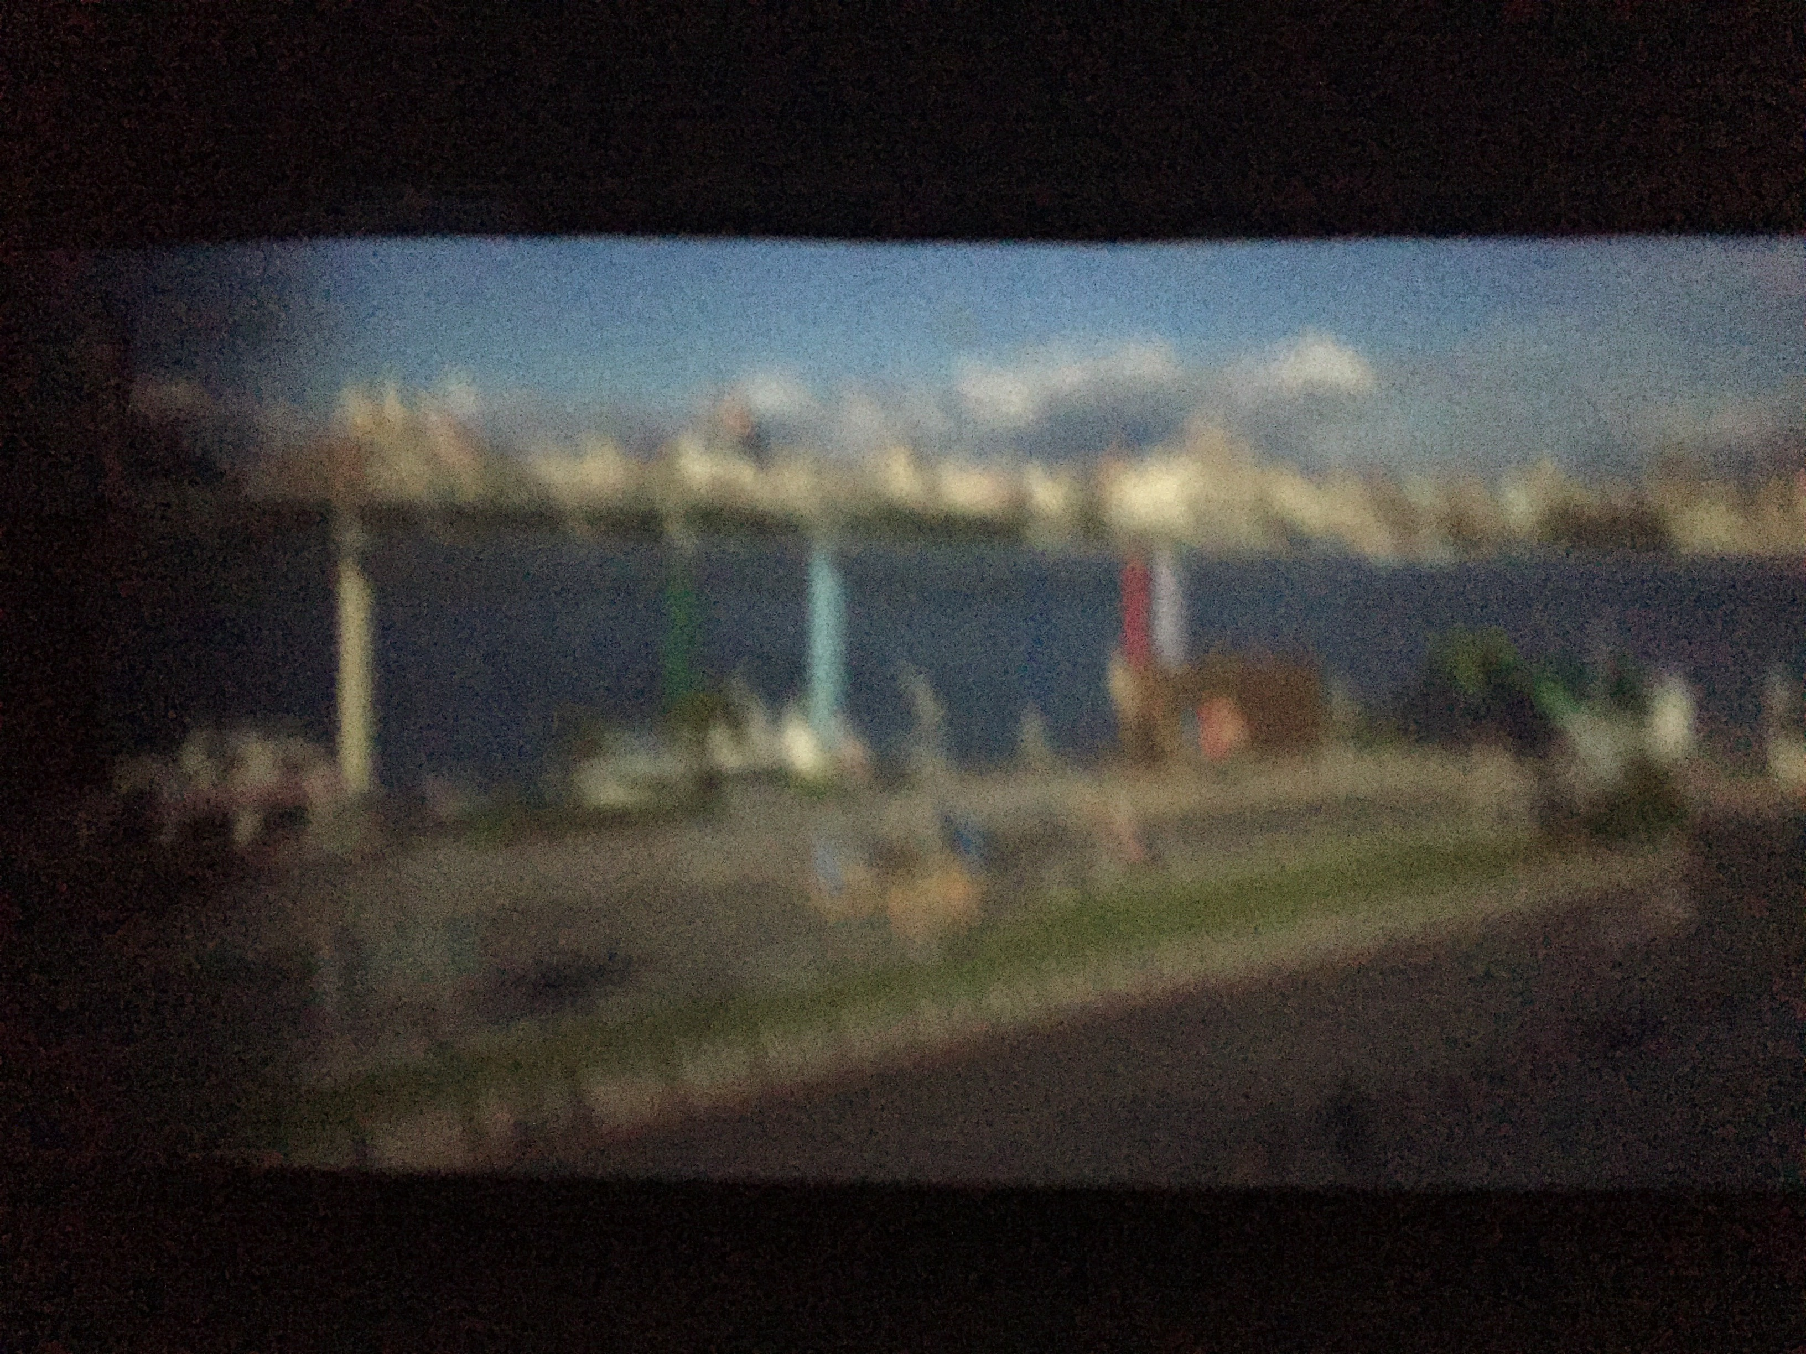
Assignment #2: Camera Obscura
Building and taking pictures with our own pinhole camera was a very good reminder that light fields and related concepts like field of view are key concepts in computational photography. We only had control over the aperture and focal length but these two alone were enough to alter the quality of the projected image on to the screen sensor taped to one side of a shoe box. Unfortunately, my aperture was not perfectly circular and in the image to the left, you can see that the tape used to make the rectangular opening smooth is actually darkening the left edge of the image. At first I thought the experiment was a total failure because I could only see shadows but increasing aperture lead to the projected image although there is signficant optical blur due to the hole size being too big.

Slide 4
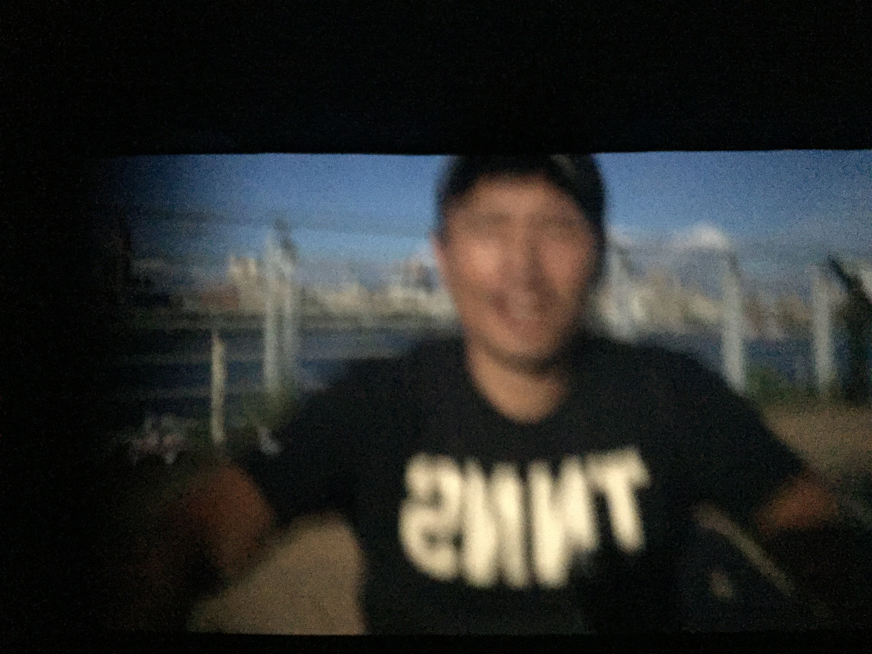
Assignment #2: Camera Obscura (cont’d)
Smaller aperture also means more diffraction blur thus the initial shadows were probably an extremely diffracted image. The accidental pinhole paper also adds to this idea of hidden images but in this case I could make out more patterns as I increased the aperture incrementally until I eventually was able to see images such as the previous and one below.
It was unfortunate that I did not have a more scientific and accurate means of increasing aperture and missed the goldilocks pinhole size that would have gave an image with less geometric blur.

Slide 5
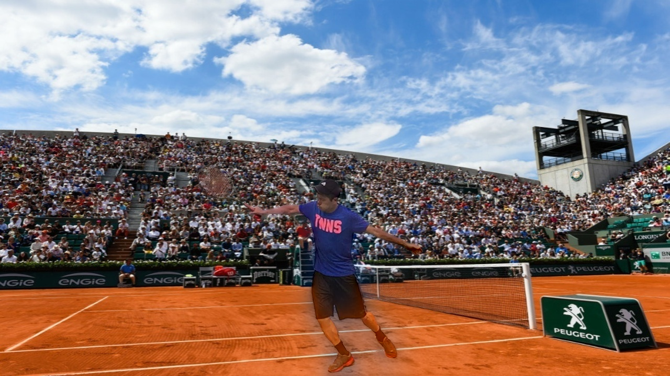
Assignment #3: Blending
Although officially complete, there is some blue haloing around the legs of the tennis player in the final image which I read to be a symptom of pyramid blending in some cases and I want to fully investigate in the near future.
The left image was the intended A&B output for A3 but resizing the mask inadvertently offset the black and white images so I had the French Open tennis background come through the player silhouette previously.
Because of that erroneous output, I learned to think a bit more out of the box to expand my creativity in using computational image manipulation to convey messages. I remember seeing the “Earth Child” output in one of the exemplary assignments which looked to be of professional quality. However, there was quite a bit of linear algebra behind that image so that is something I plan on improving.
The introduction to Laplacian pyramids which effectively act as band pass filters at each layer (for one octave) and the ideas behind Burt Adelson were excellent and the basis for my final project to a large extent. Also multiplying the black and white images by the feathered mask values was new since before this I had only used masks as binary or boolean values.

Slide 6
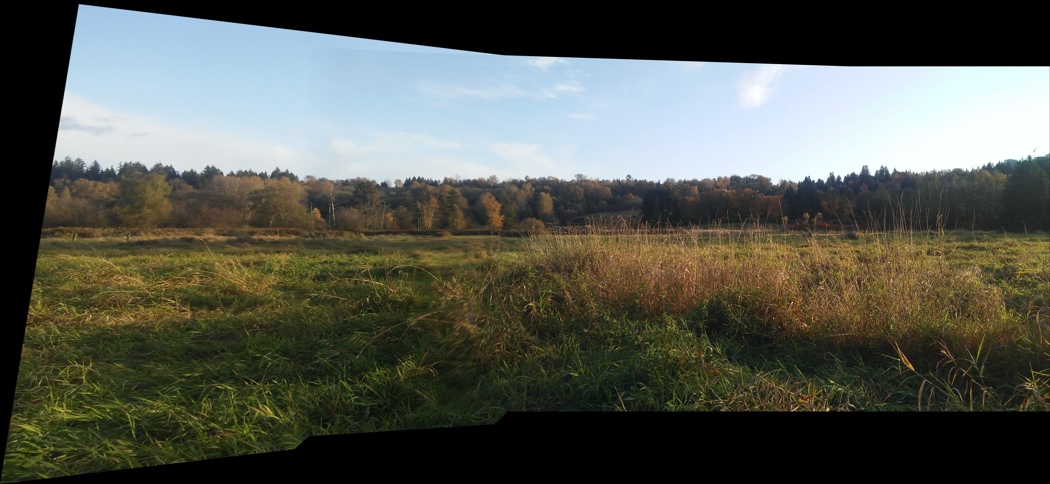
Assignment #4: Panoramas
The “meadows” image reminiscent of autumn days golfing with my dad out in Richmond, BC. For thie project, I implemented an alpha blend in the overlay area starting from the low energy seam found using the midterm code but upon viewing some of the exemplary assignments it may have been better to create masks based on the seam and alpha blended the entire overlay region or implement the cut shown in the lecture more faithfully. One of the exemplary assignments by another student was very informative for this.
I also practiced alternating warps from the left and right which seemed to allow for more images to be concatenated before the vertical lines started getting warped towards the middle on the edge images.
It was good to learn about feature based matching using open source ORB and SIFT which is not, but I still need to learn more about how scale invariant feature detection works. I did notice howerver that again the Laplacian is used here in detectors such as Harris-Laplace so that is good to know that there are some common underlying ideas across modules.
I also learned the many different OpenCV routines related to warping, homography and other transformation matrices and their degrees of freedom, the ability to combine transformations and projection planes including the planar shown above, cylindrical and spherical which would enable a 360 degree panorama.

Slide 7
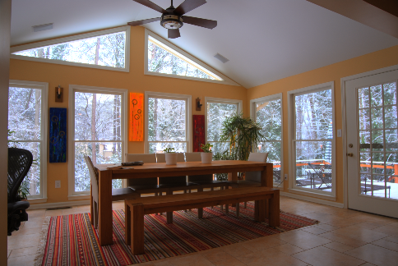
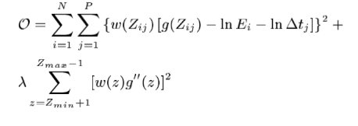
Assignment #5: HDR
Due to the limitations in the dynamic range of display devices and other mediums that serve as film, in this project we implemented the Debevec and Malik algorithm to recover the film response curve and implemented a high dynamic range radiance map, with values far exceeding the [0,255] range for a 24 bit RGB image, from observed pixel values in an exposure stack of images with known expsosure times.
The gist of the algorithm was to minimize the following quadratic objective function where g is the unknown response function, w is a linear weighting function to emphasize smoothness fitting terms towards the middle of the curve, t is the exposure time, E is the unknown radiance, Z is the observed pixel value, I is the pixel location index and P is the total number of exposures.
Still needs parameter tuning...

Slide 8
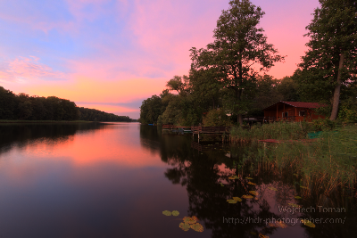
Assignment #5: HDR (cont’d)
“This response curve can be used to determine radiance values in any images acquired by the image processing associated with g, not just the images used to recover the response curve.” The second equation to construct the radiance map is:
All available exposures for particular pixels are used with more weight given to exposures where pixel values are closer to the middle of the response function for the above equation.
The resulting radiance map can be normalized, clipped, gamma-corrected or tone-mapped using an existing algorithm or a new one. However, I still prefer exposure fusion which is much less computationally intensive.
In hindsight the colors are a bit unrealistic and too dark in some regions.

Slide 9
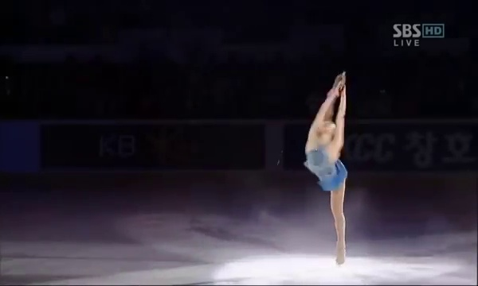
Assignment #6: Video Textures
I began with the goal of constructing a “never ending rally” between Federer and Nishikori but this did not materialize as the algorithm is limited to certain types of repetitive motions that are independent and do not overlap.
Thus, I opted for a real-life music box ballerina in the form of Yuna Kim performing a Biellman spin which produced matrices with repeating patterns of diagonal lines and near circular paths back to the “lines of most similarity”. For A&B, I opted to not use the formula with the alpha value but rather to pick spots based on the intensity value of pixels in the difference matrices.
I learned the importance of visualizing results with Diff1, Diff2 and the Score matrix and will surely apply similar methods in the future rather than depend on numerical output only. Convolving with a diagonal binomial filter was also something new that surely has to find a place in my tool box.
I am hoping to be able to construct the “forever rally” and use it in conjunction with the open source structure from motion to make a tennis tutorial app.
Left: Similarity matrix for the Yuna texture with uniform diagonals and repeating circles.
Link to video texture of Yuna: https://drive.google.com/open?id=171G0cc2QAsy_2W2PIAqn0tQ4uK8j9sg9

Slide 10
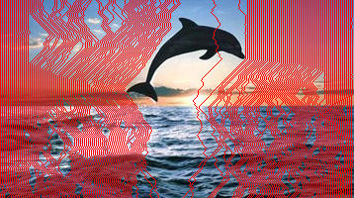
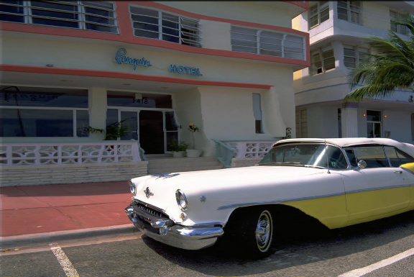
Midterm Project
The main issues with seam carving also referred to as “content aware image resizing” were in producing a good energy map (using a 2D 3*3 Scharr filter and summing the absolute values of dx dy of RGB channels) and proper ordering and offsetting of the seams when images were expanded. The energy map was critical in finding the lowest energy seam as a 3*3 Sobel filter did not work so kernel size had to be set to -1 in the OpenCV routine for Sobel to envoke the Scharr filter. Dynamic programming is much more intuitive compared to recursion for me but the overall simplicity of the algorithm to make the cost map threw me off as I overengineered some aspects. However, I still need to go back and vectorize my code with my upgraded numpy skills.
After seeing Patch Match’s improvement over this algorithm for some images, I am even more motivated to attempt implementing it.
Here I also learned how to use some new data structures in numpy, basically arrays that can hold objects which was a life saver as I previously thought this library was only for math related functionality.

Slide 11
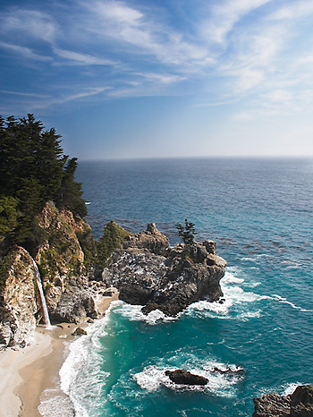
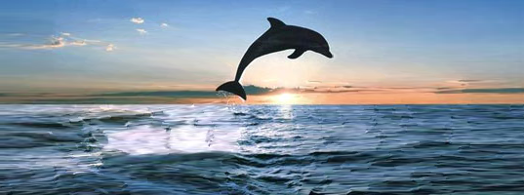
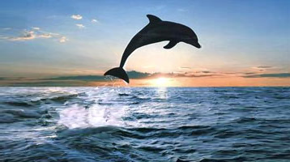
Midterm Project
Top dolphin image is 2 incremental expansions of 50% but results in artifacting with stretch marks in the water/splash. The bottom dolphin is one expansion of 50% and looks “pretty”.
The reduced beach picture still has a nice waterfall and the waves and other areas look natural.

Slide 12
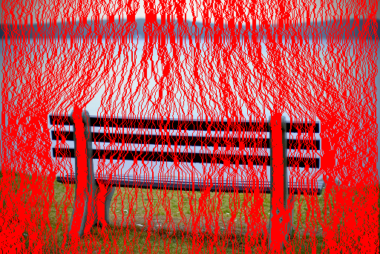
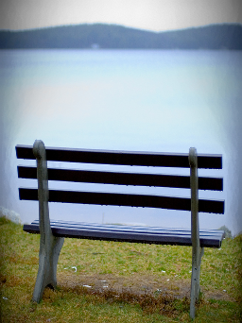
Midterm Project
The above right bench looks much better reduced with 2008 “forward energy” compared to the reduction via 2007 algorithm that can be viewed in the original paper. The left image shows how the seams envelope the bench more evenly compared to the 2007 implementation since it considers what pixels become neighbors after removal.

Slide 13
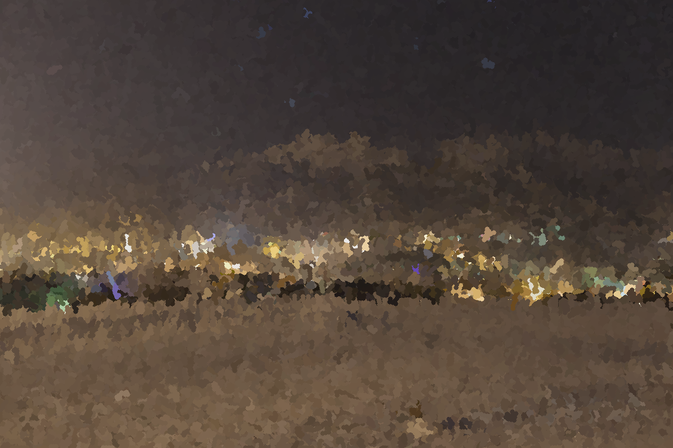
Final Project
From focus-stack or exposure-stack to painterly was an ad-hoc project idea I stumbled while focusing on Laplacian pyramids possess amazing capabilities to high pass filter image frequencies at each octave using the kernel subscribed by Burt and Adelson. Discrete Fourier Transform for images is an abstract concept I am still trying to wrap myhead around so I chose Laplacians which seem to serve as a spatial representation of filtering using frequency spectra info about images.
Implementing painterly based on Litwinowicz and Hertzmann allowed me to produce satisfactory looking paintings although I still need to threshold gradients to find edges rather than rely solely on Canny edges. I had a chance to experiment more with various image manipulation libraries and plan extend the idea to video by using feature detection introduced in the lectures.

Slide 14
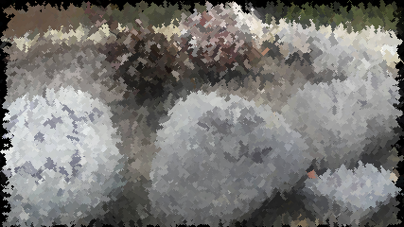
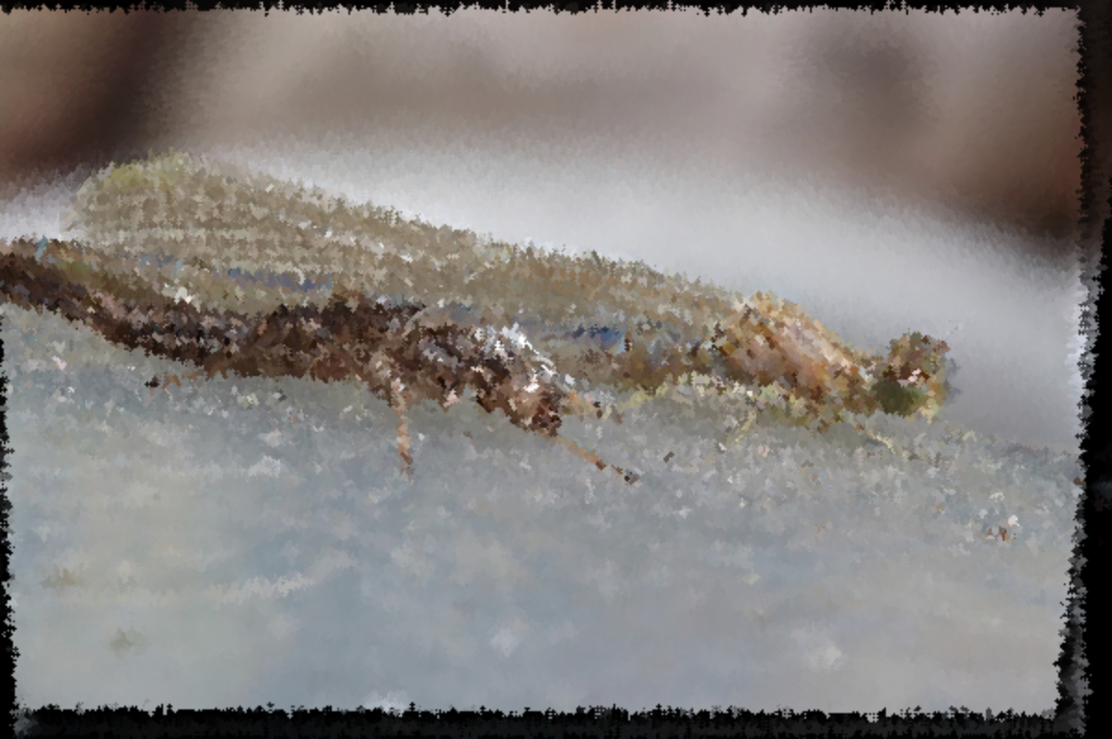
Final Project (2)
The bottom image I went for max realism with the smallest radius and stroke length possible(1 and 3 respectively). Segmentation of foreground and background is the next logical step and varying brush characteristics depending on the detail level required in each. I definitely want to apply the focus stacking and painterly to macrophotography as soon as I can buy a camera that is capable.
The top image came out surprisingly well as I did not expect a bunch of rocks and pine cones to look artistic (or maybe my sense of artistic is not yet sophisticated). Both of the source images are focus stacked using Laplacians pyramids.
Which makes me wonder, is there any way to render a painterly image using Laplacians? If features can be separated into octaves based on size, perhaps I could adjust brush radius and stroke length per pyramid layer to obtain the effects I want. But would this be computationally efficient enough? I brought this up with classmates on Slack and want to pursue it further.

Slide 15
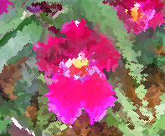
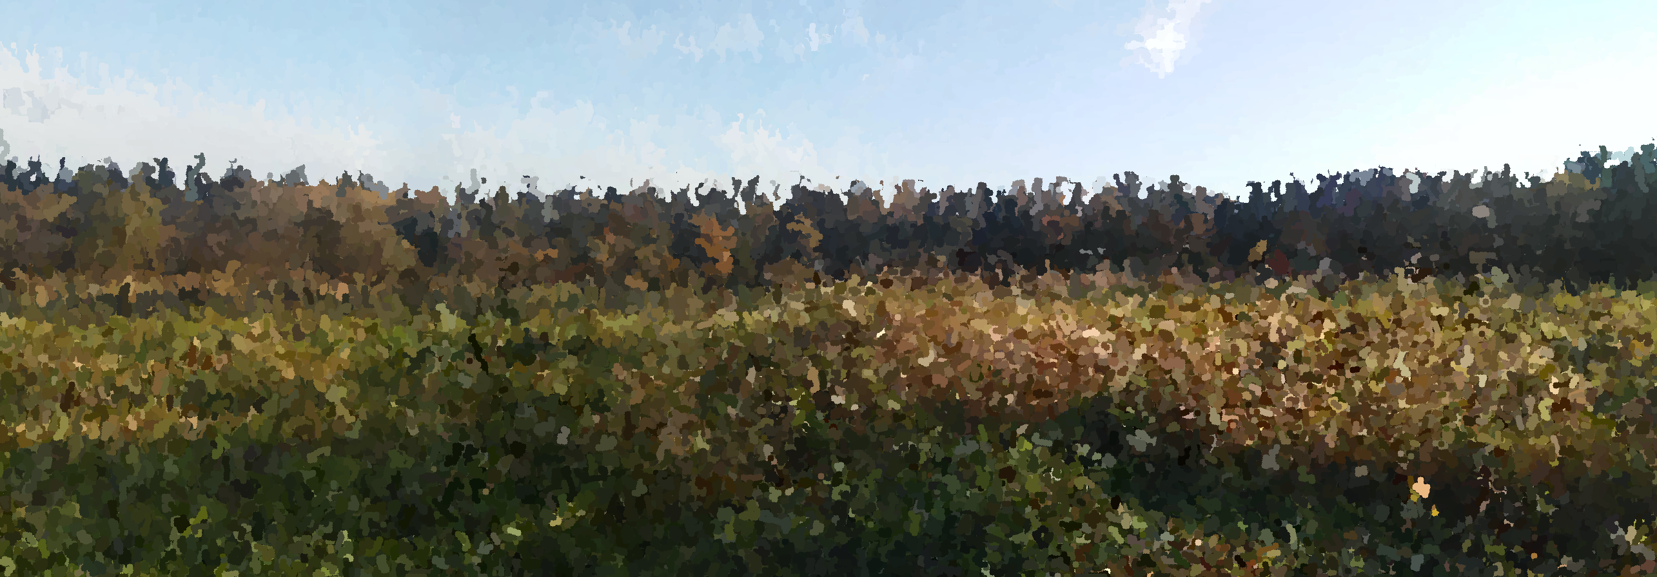
Final Project (3)
Not quite Van Gogh but still looks somewhat pretty with brush radius of 2 and stroke length of 7.
Below, the meadows panorama image from A5 painted with the updated edge conditions based solely on Canny edges. Stop immediately if cx, cy starts on an edge and leaves the edge and draw one last circle if the opposite. Still need to integrate gradient magnitude here and threshold.

Slide 16
I forgot to mention that I attempted video stabilization for my Final Project but quickly became discouraged as it seemed much more difficult than the midterm. However like all other things, I think it’s best to gradually build up to implementing more difficult algorithms so that is something to aim for within the next year. My list of extensions to the assignments are: to implement a cylindrical or spherical panorama, investigate more into percentile stretching and other post-processing methods, look into reblending panorama, adding more sophistication to my painterly, continue to work on the “forever rally” video texture and implement object removal for seam carving. Finally, I received very informative feedback from TA Trent and a classmate who commented on homography and camera calibration for my tennis line calling app idea on Piazza so that is useful advice to build on. Thank you for making my first OMSCS course rigorous and definitely a confidence booster. Having a portfolio outside of the limited deep learning stuff I have done as personal projects is nice and seeing some of the exemplary reports has really motivated me to do attempt more. The interaction with classmates on Slack and Piazza were unlike any other online course I have taken and a definite plus to feel like I am a part of a community.

